Slide 1
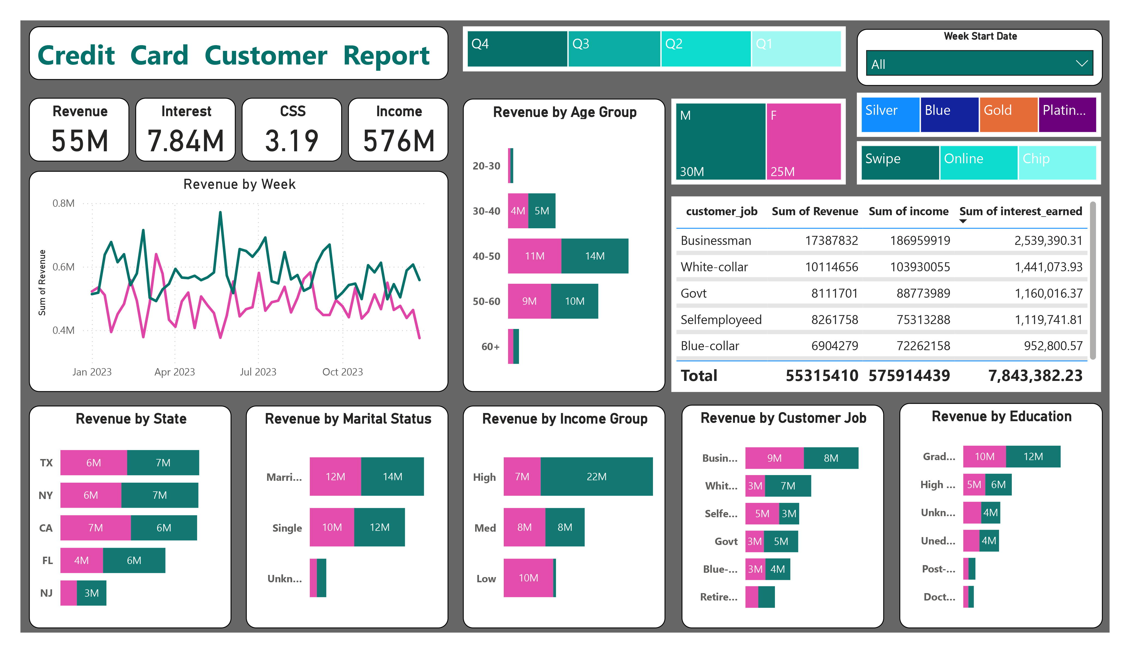
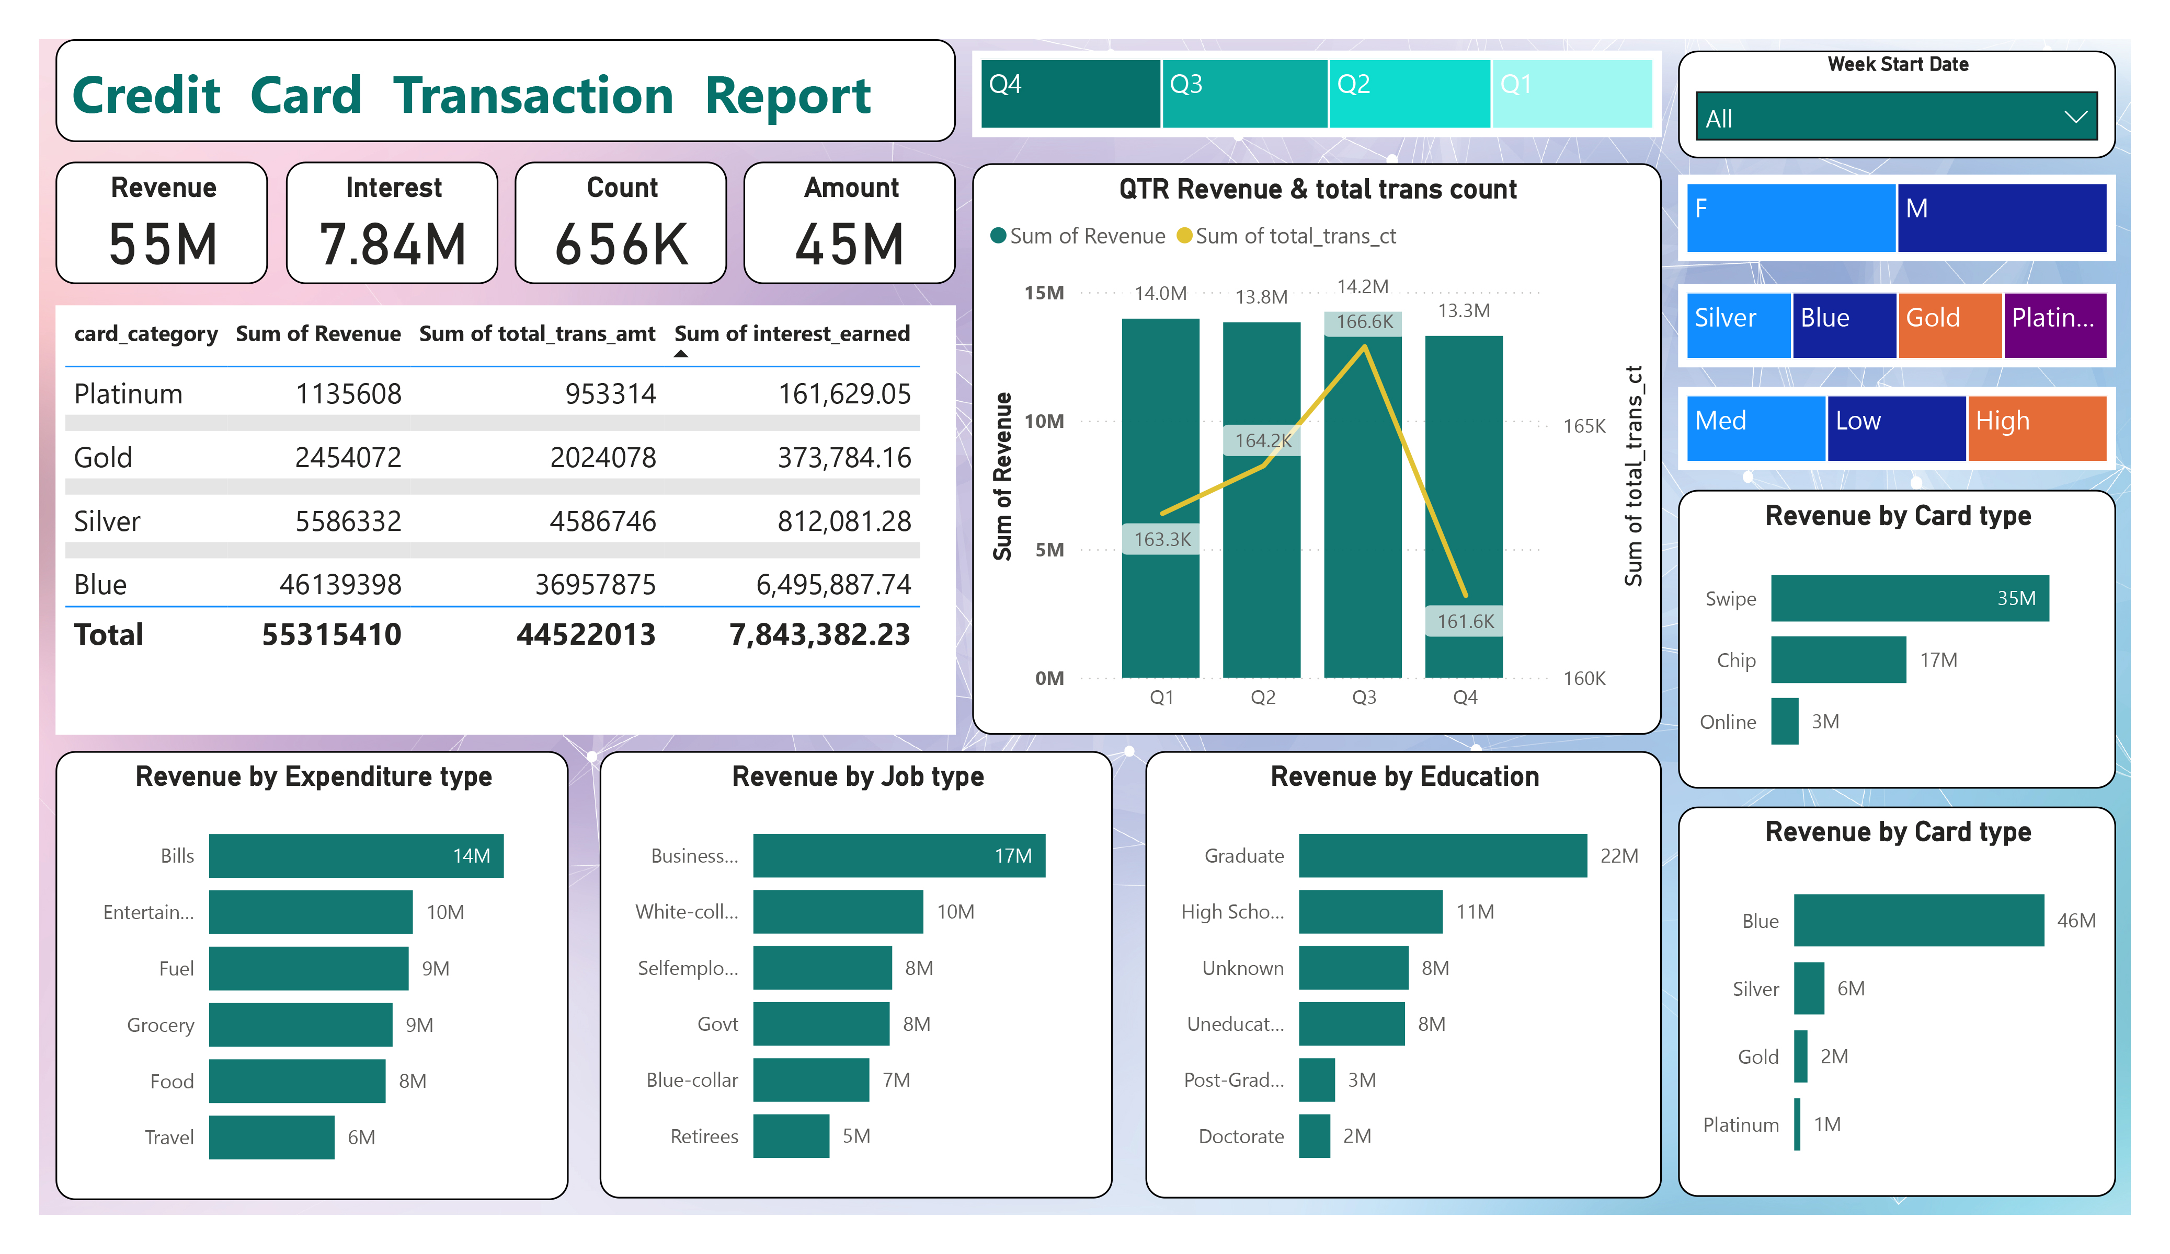
Credit Card Analysis Dashboard
Presented by: Samrat Bikram Shah
Date 25 April 2025

Slide 2
Objectives
To analyze credit card revenue, transaction count, and interest earnings.
To understand customer behavior by card type, job, education, and demographics.
To identify the top contributing categories for strategic business decisions.
To evaluate performance trends across different quarters and states.

Slide 3
Key Metrics Overview
From Both Dashboards
Total Revenue: $55M
Interest Earned: $7.84M
Total Transactions: 656K
Total Transaction Amount: $45M
Customer Satisfaction Score (CSS): 3.19
Customer Income: $576M

Slide 4
Revenue & Transaction Analysis
Chart: QTR Revenue & Total Trans Count
Q3 generated the highest revenue ($14.2M).
Q3 also had the highest transaction count (166.6K).
Overall consistent performance across quarters.

Slide 5
Card Category Performance
Table & Bar Chart
Top Performer: Blue card – $46M revenue
Platinum contributed the least – $1M
Majority of interest earned from Blue card users: $6.49M

Slide 6
Spending Behavior by Expenditure
Top Revenue Generators:
Bills: $14M
Entertainment: $10M
Fuel & Grocery: $9M each
Travel: $6M

Slide 7
Customer Profile by Job & Education
Insights:
Top Job: Businessman – $17.3M revenue
Education: Graduates contributed $22M
White-collar and Govt employees also contribute significantly.

Slide 8
Demographic Insights
Gender & Age Group Breakdown:
Males (30M) contributed more revenue than females (25M).
Highest revenue from age group 40–50 (M: 14M, F: 11M)
Income Group:
High-income customers: $22M revenue (M), $7M (F)

Slide 9
Regional & Marital Status Analysis
States:
Top Revenue States: CA, NY, TX
Marital Status: Married customers generated higher revenue

Slide 10
Summary & Recommendations
Focus on Blue card holders for promotional campaigns.
Target graduates and businessmen for premium offers.
Enhance card benefits for fuel and grocery spending.
Encourage high-income and 40–50 age group for loyalty programs.

Slide 11
The End

